Slide 1
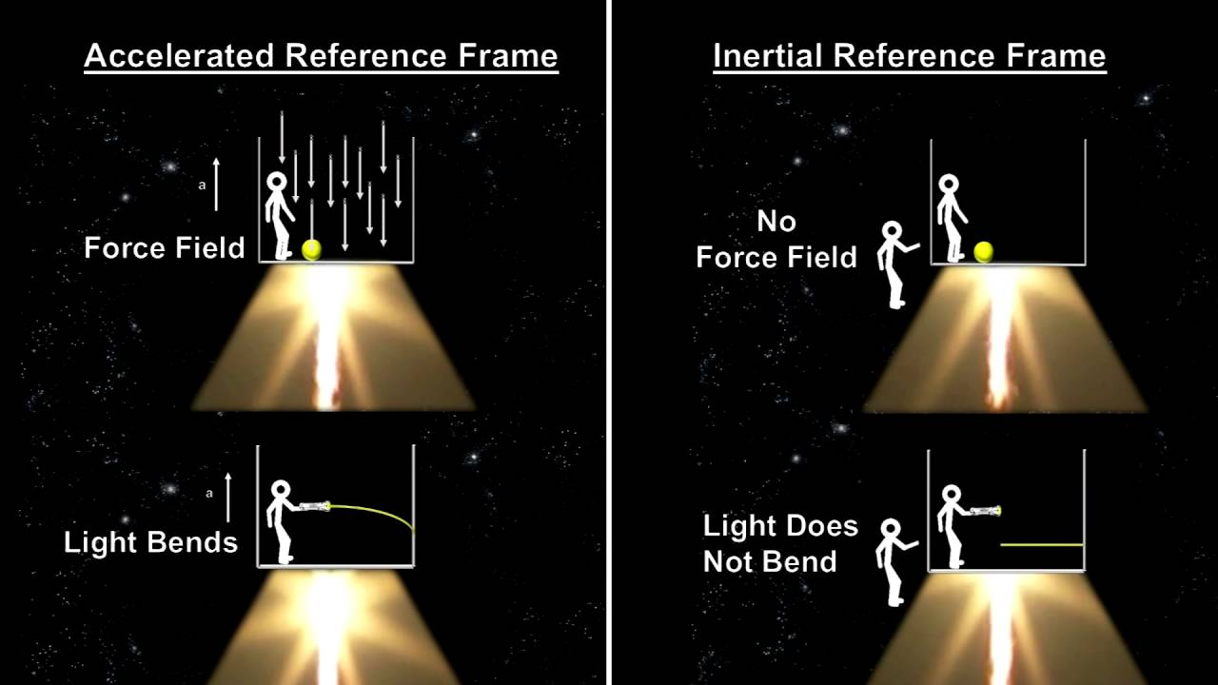
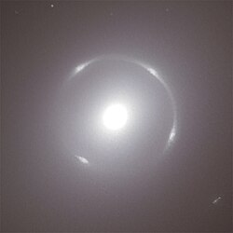
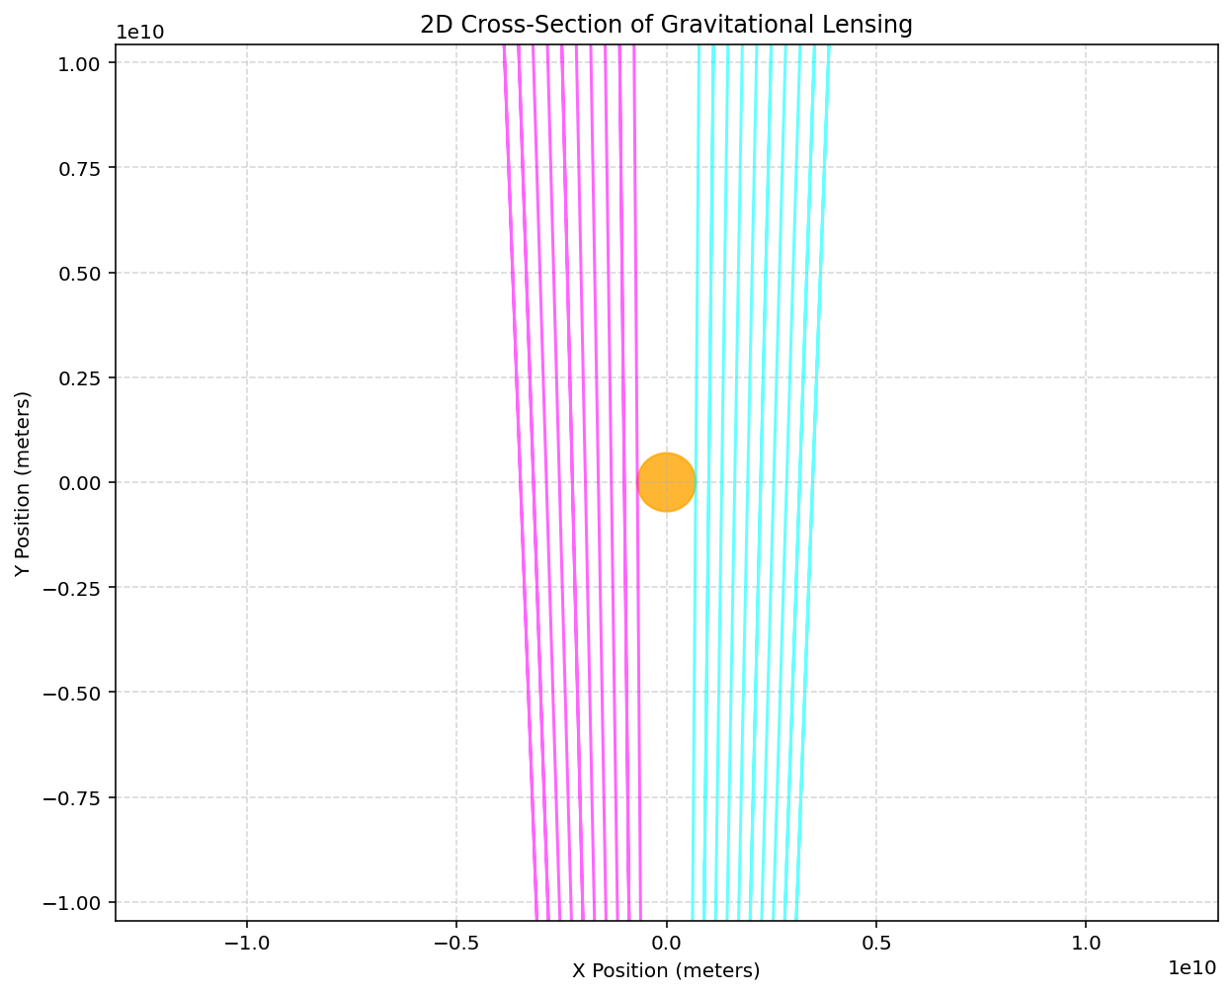
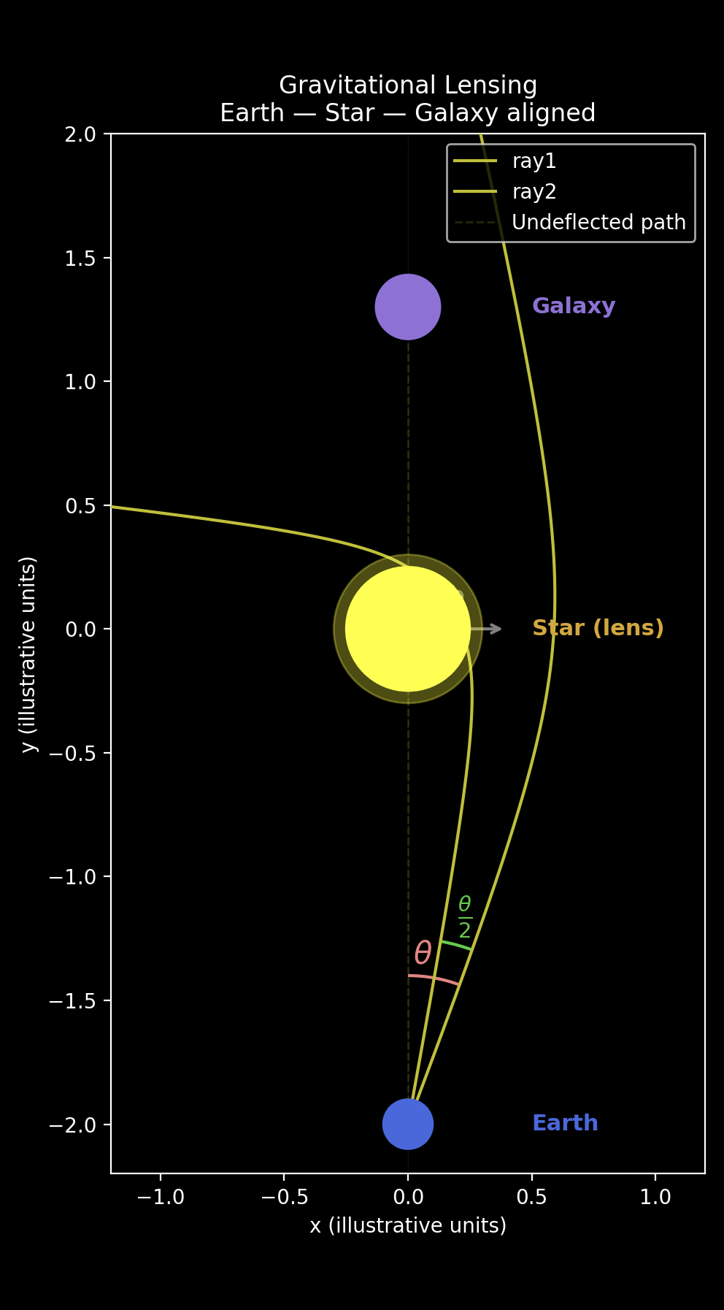
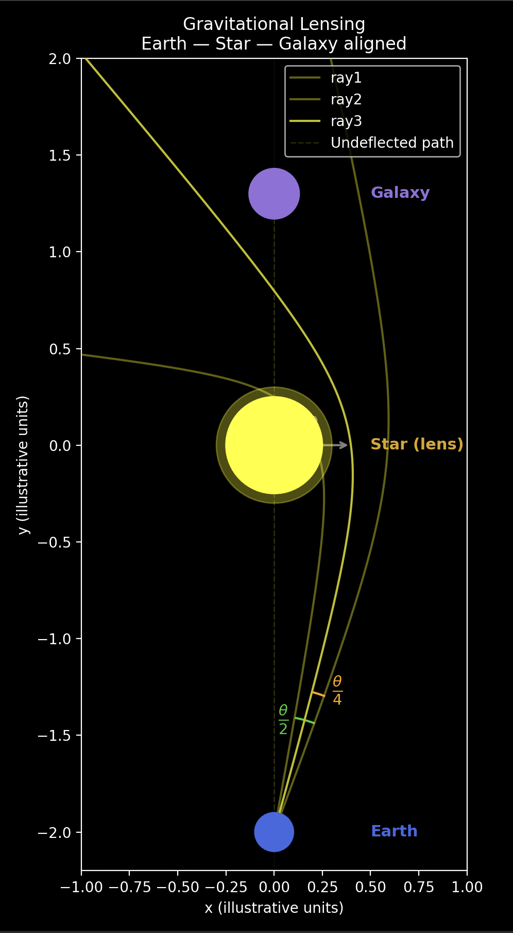
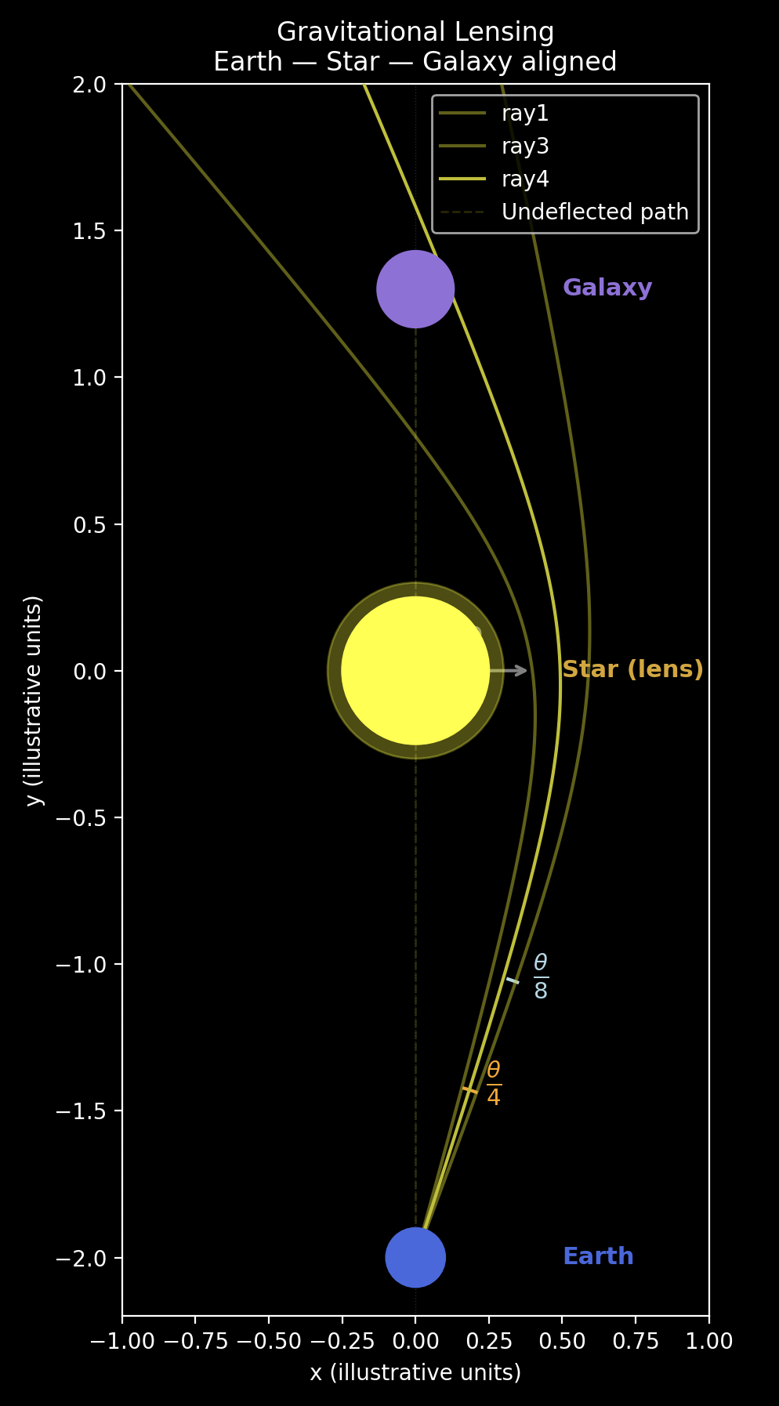
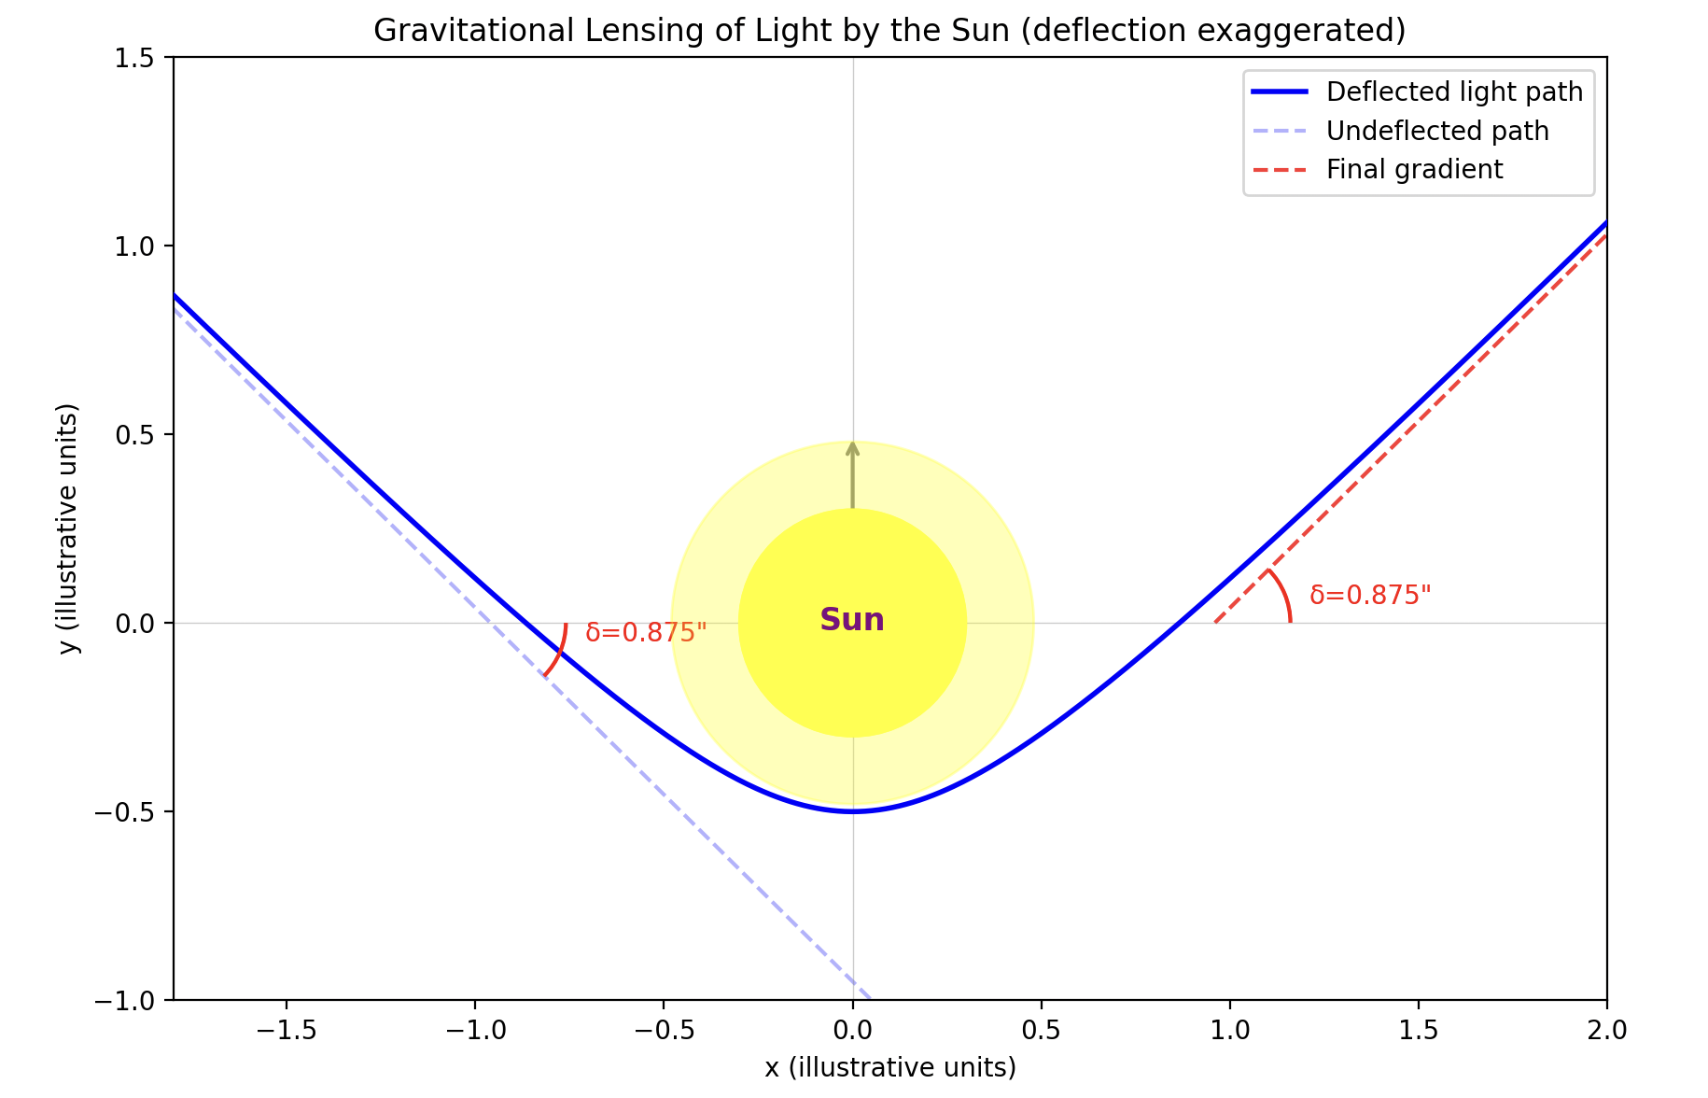
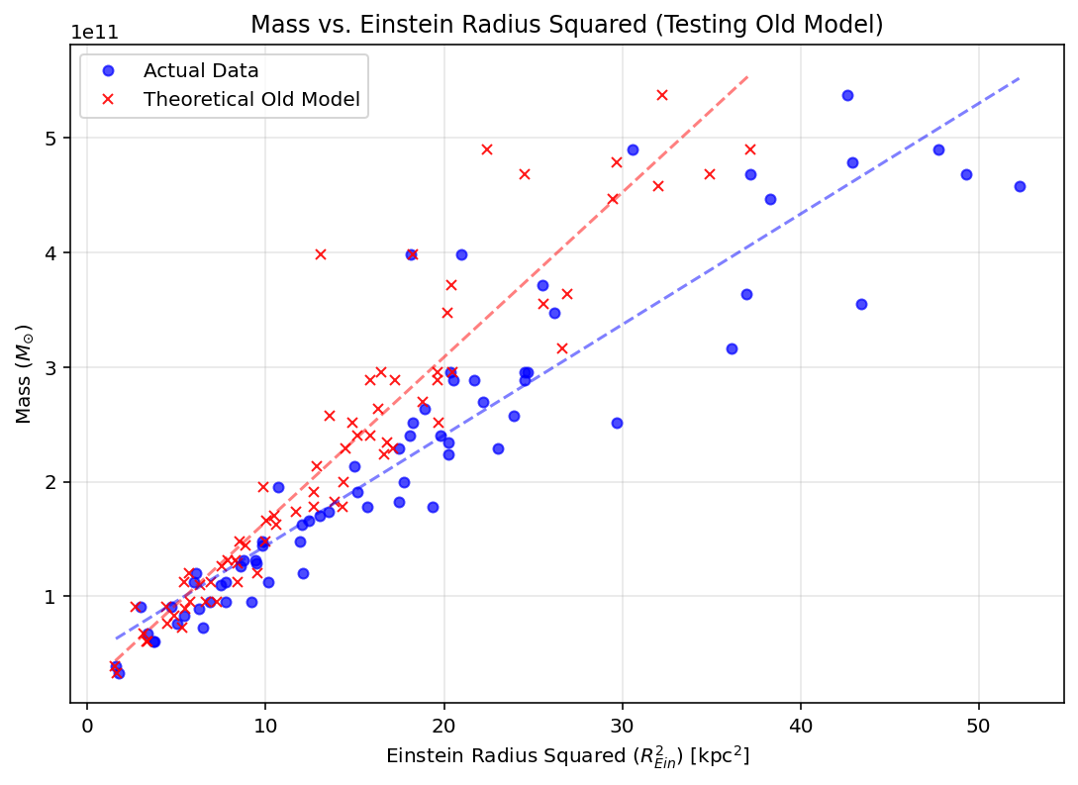
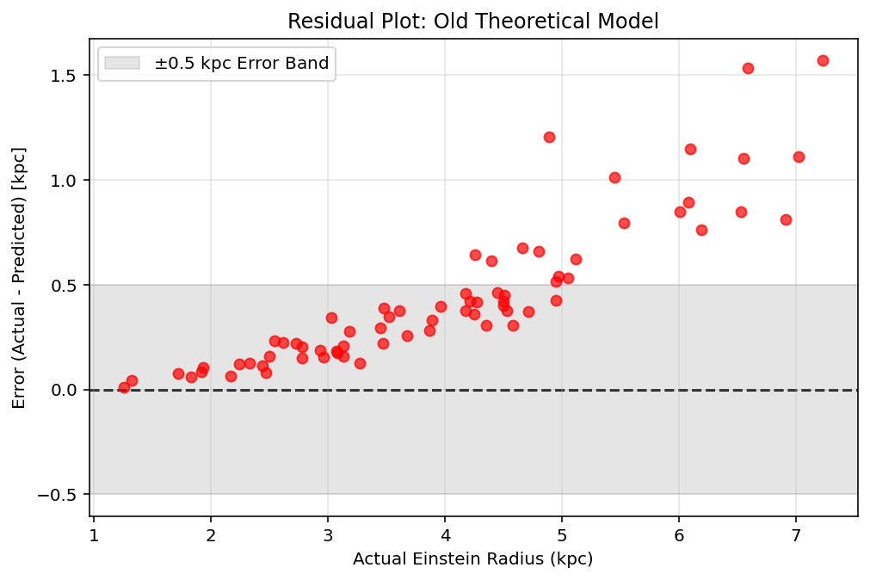
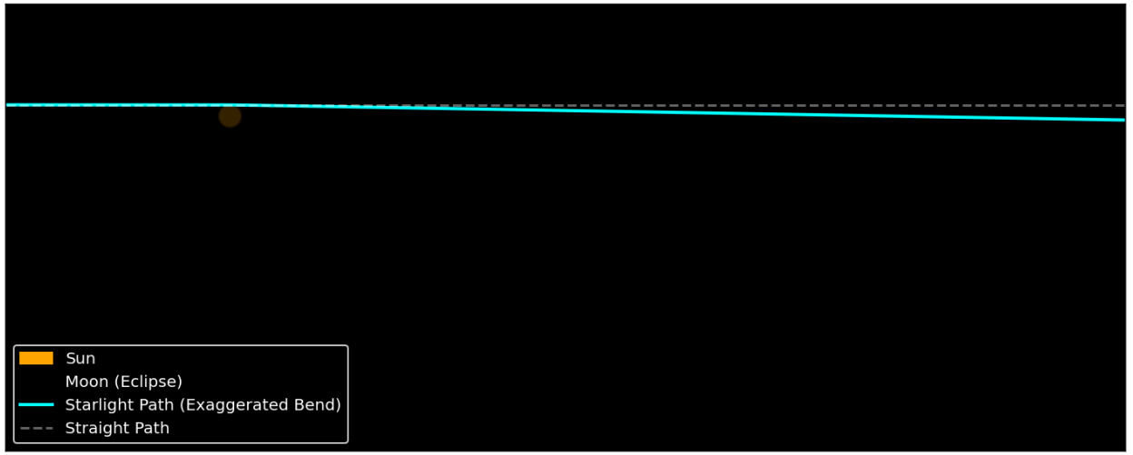
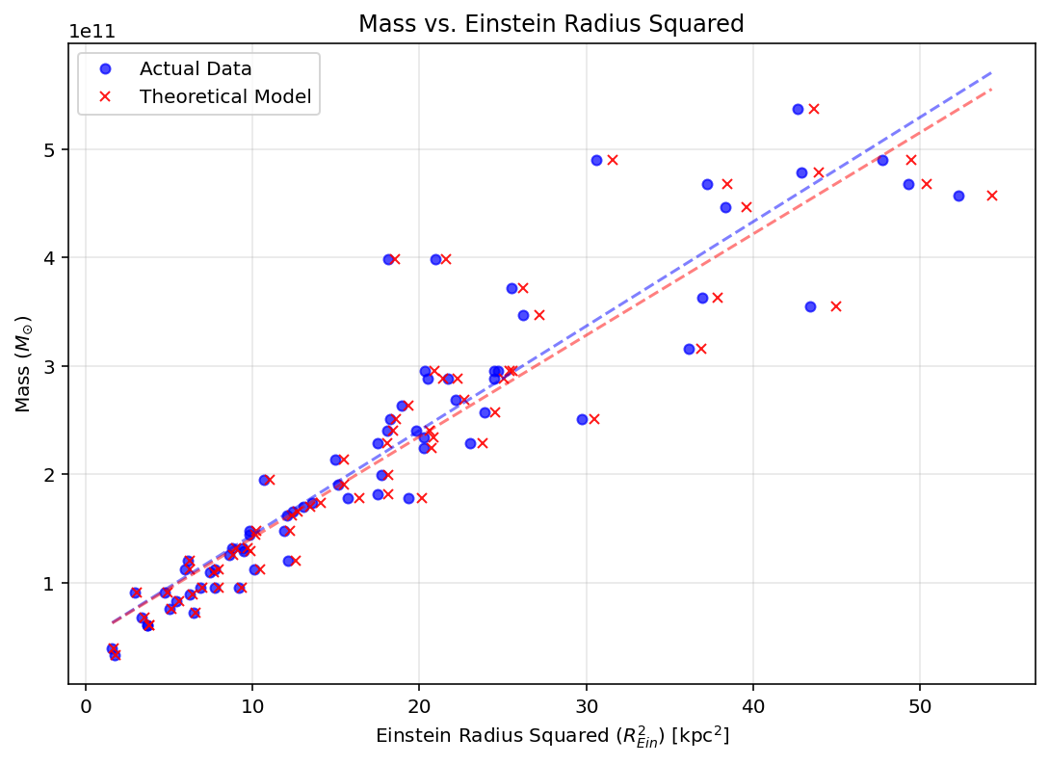
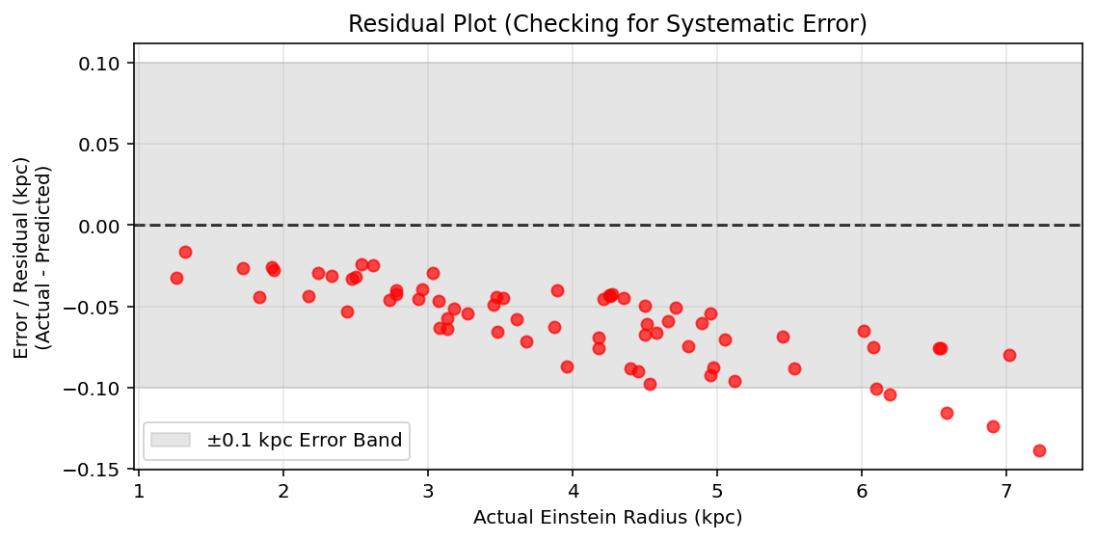
Gravitational Lensing
1. Equivalence Principle
Einstein determined that light bends around large masses, due to gravity. A ring of light can often be seen around large objects, called Einstein rings.
2. Aim
We used this principle to create a computational model for light bending around the Sun, using a geodesic equation, rk4, and by searching for the impact parameter using binary search. We wanted to see the relationship between the ring radius and the object’s mass.
Rk4 image?
3. Binary Search
An initial guess is made for a light ray to trace, and binary search essentially halves that guess, and goes higher and lower by a half each time until the light falls into the large object. This is how we were able to find the radius of the Einstein ring. The angle through which the ray is fired and falls into the object, is the angular radius of the Einstein ring.
4. 1.75 arcseconds
In Eddington’s 1919 experiment, during an eclipse, he was able to observe how the light from surrounding stars was bent around the sun, and could be pictured during the eclipse. It was bent by 1.75 arcseconds. This is the value we were looking to achieve with our model, and we did.
5. Extending to all large masses + Failures
After we successfully modelled the Sun, we now wanted to find a general model for all large masses through raytracing. Our initial equation for the model used distances such as Observer→Lens, Observer→Source, Lens→Source. However, DLS did not equal DS-DL. This was due to the expansion of the universe.
There is a clear systematic error
1.75!!!!
This model was not very reliable:
R-Squared: 0.8494 (Closer to 1.0 is better)
MAPE: 9.62% (Average % error)
RMSE: 0.5611 kpc
6. Our Updated Model
Instead of using this model, we used a slightly different one, which ignored the distances and instead used (IDKKKKKKKKKK). This model was compared to the dataset which we had access to, and the model was shown to be reliable, as it was not significantly different to the data.
However, as can be seen here, there is still a very small systematic error in the model, which is causing it to overestimate the radii of the rings.
Our final model was very reliable:
R-Squared: 0.9980 (Closer to 1.0 is better)
MAPE: 1.52% (Average % error)
RMSE: 0.0649 kpc
MAE: 0.0598 kpc

Slide 2
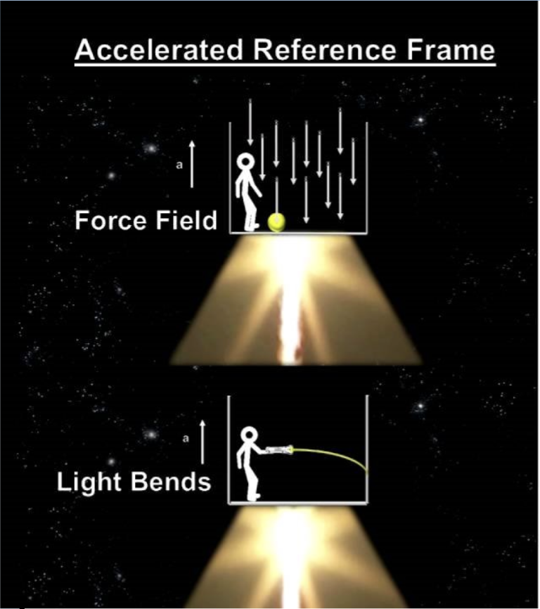
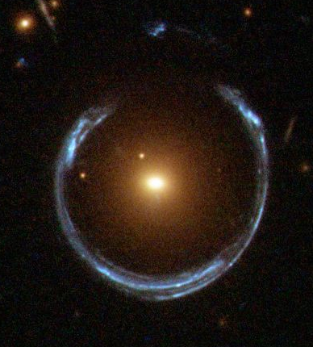
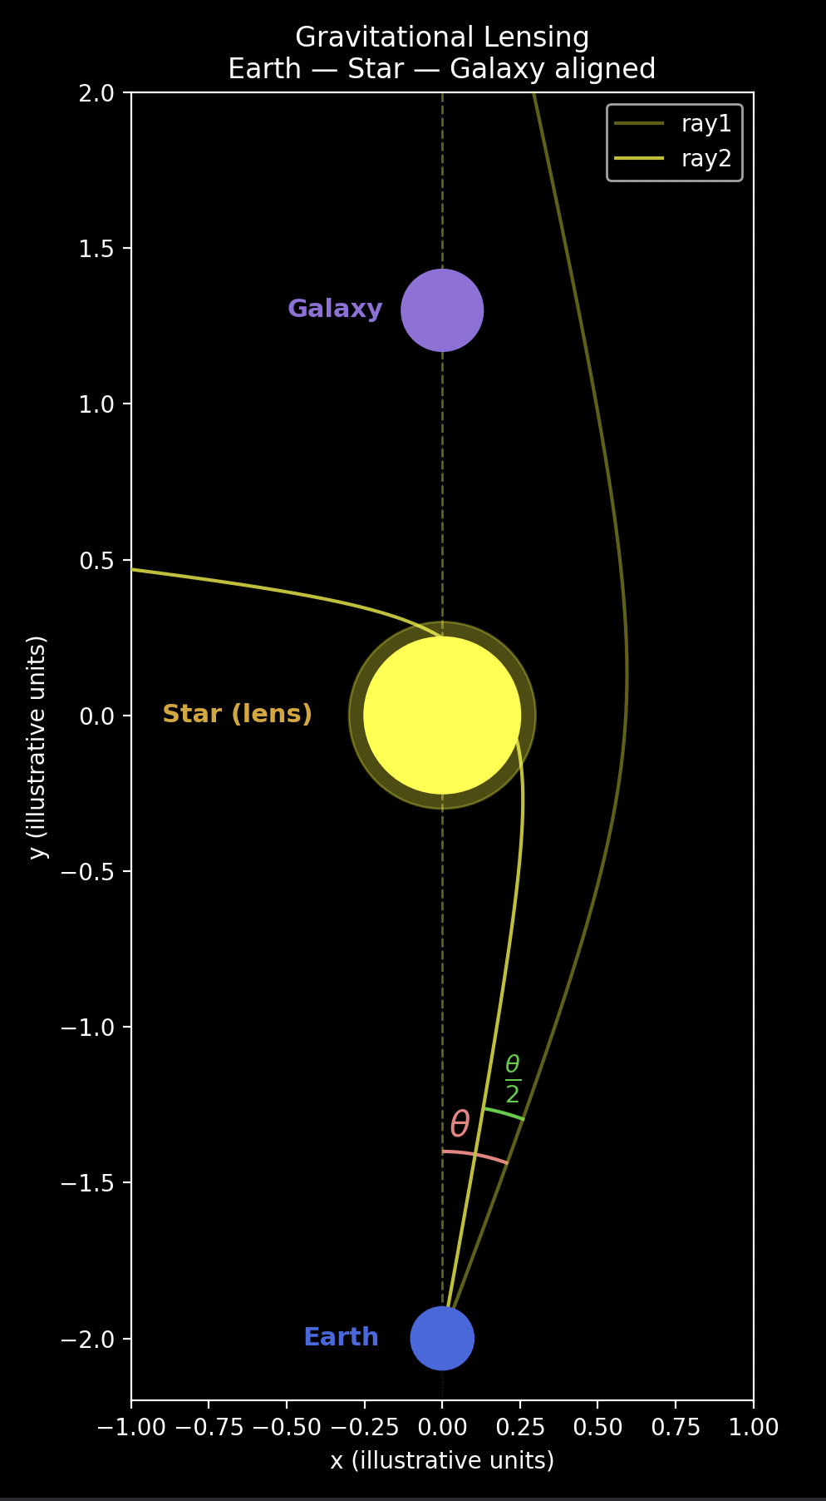
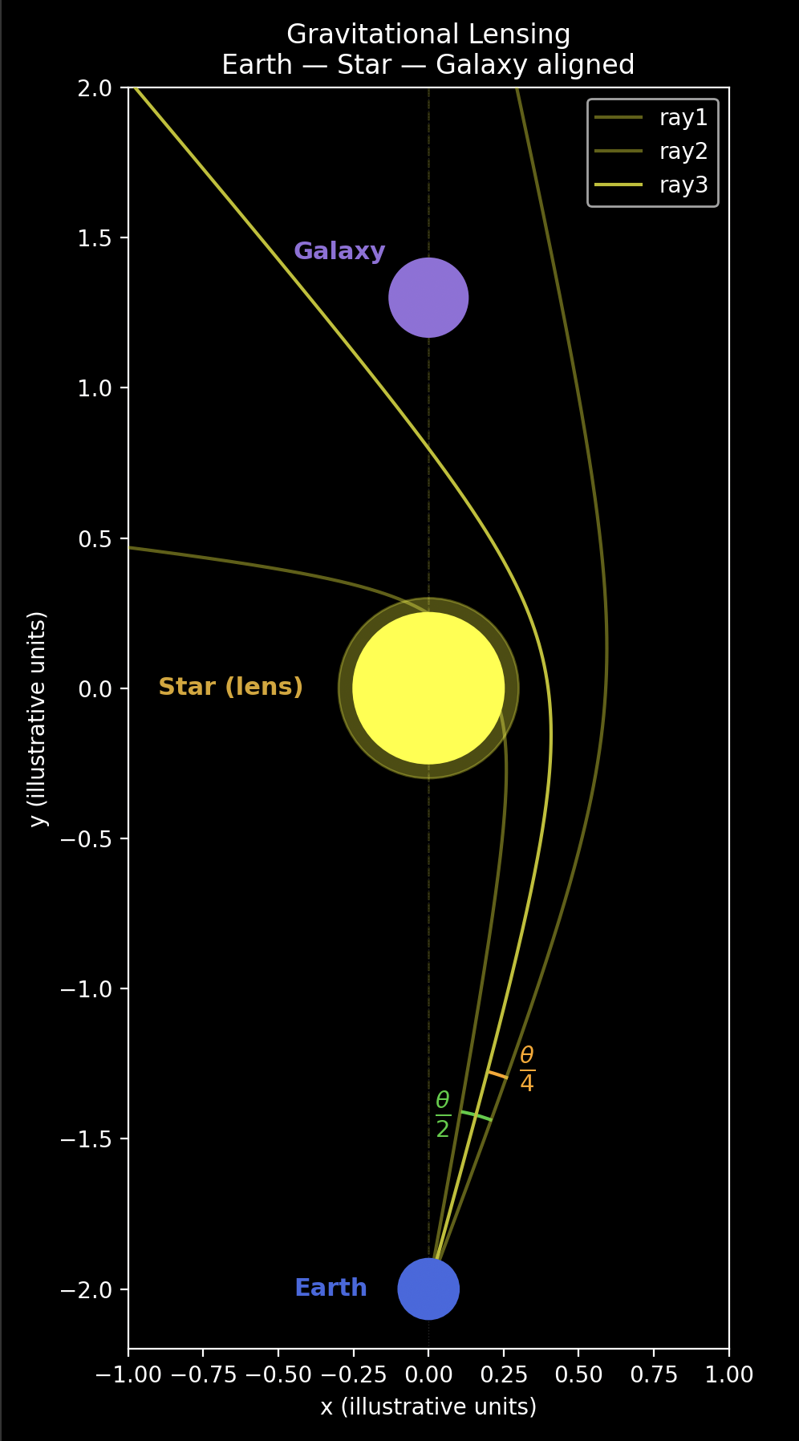
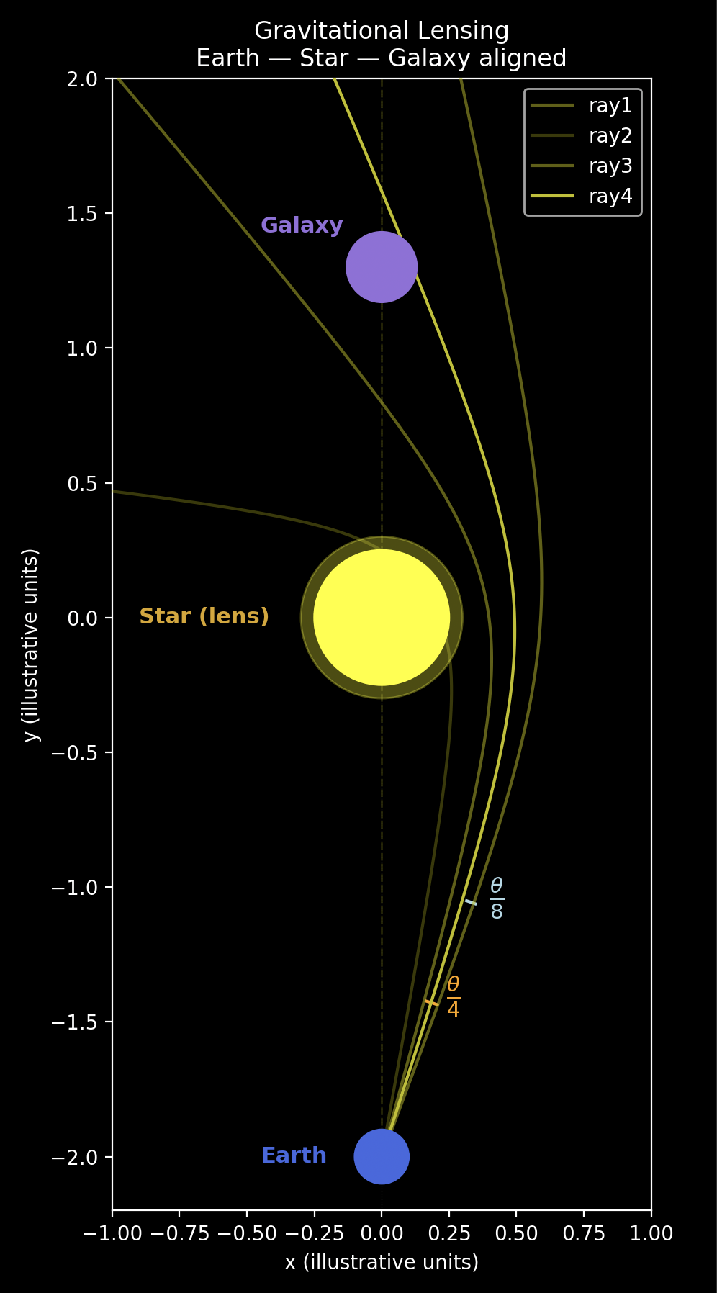
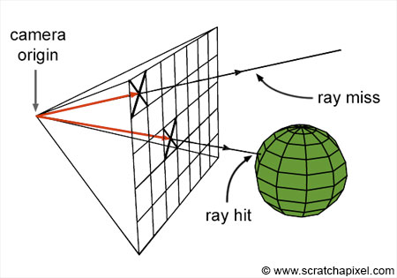
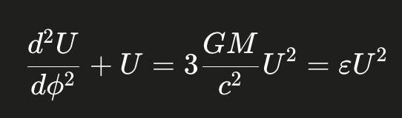
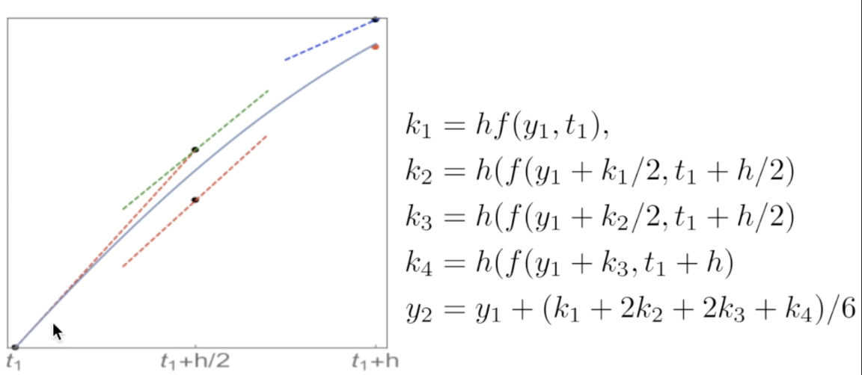
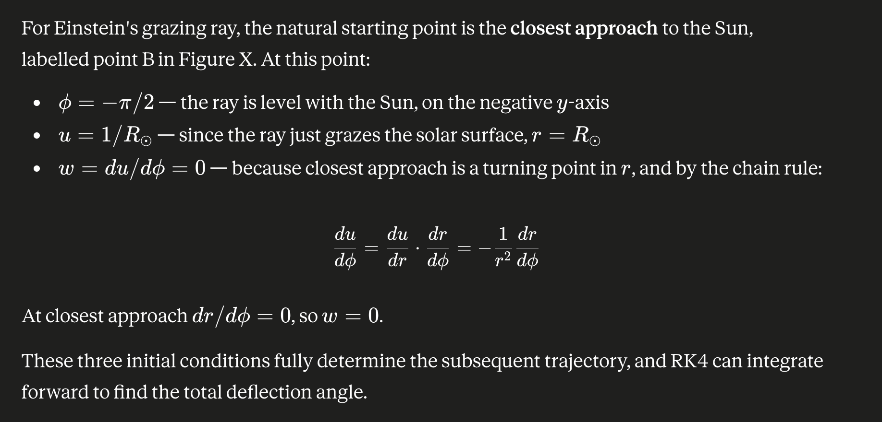
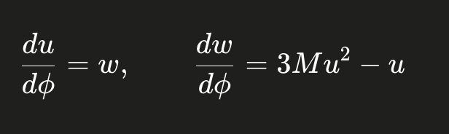
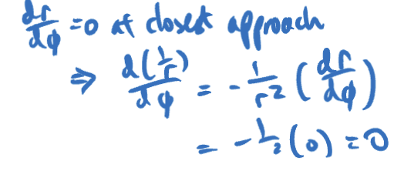
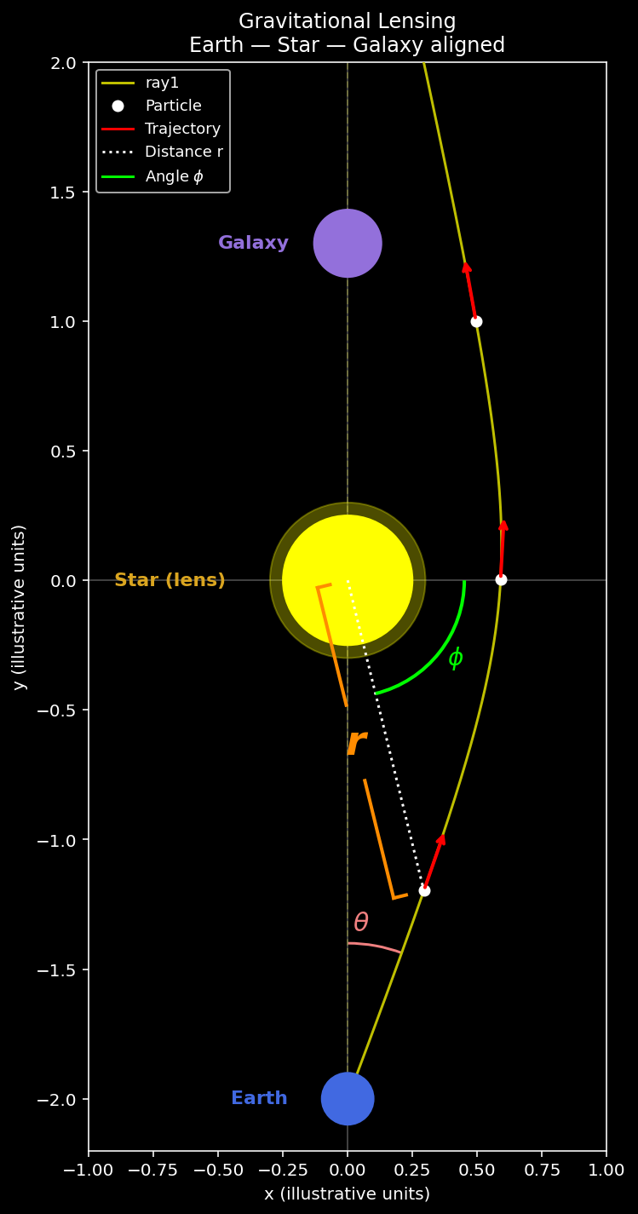
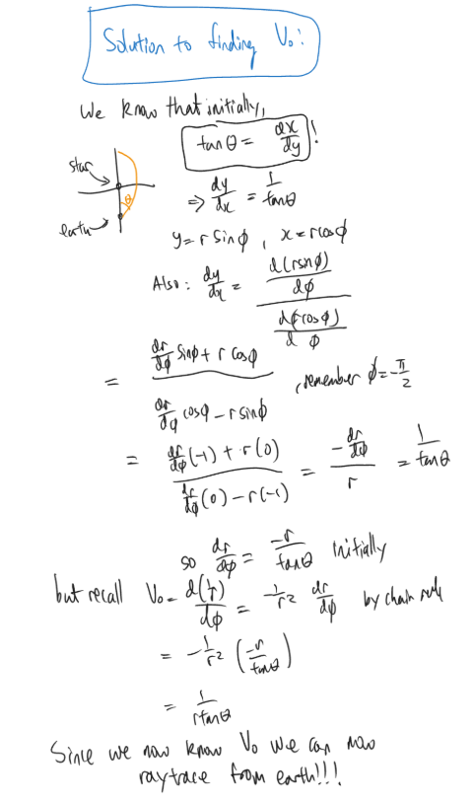
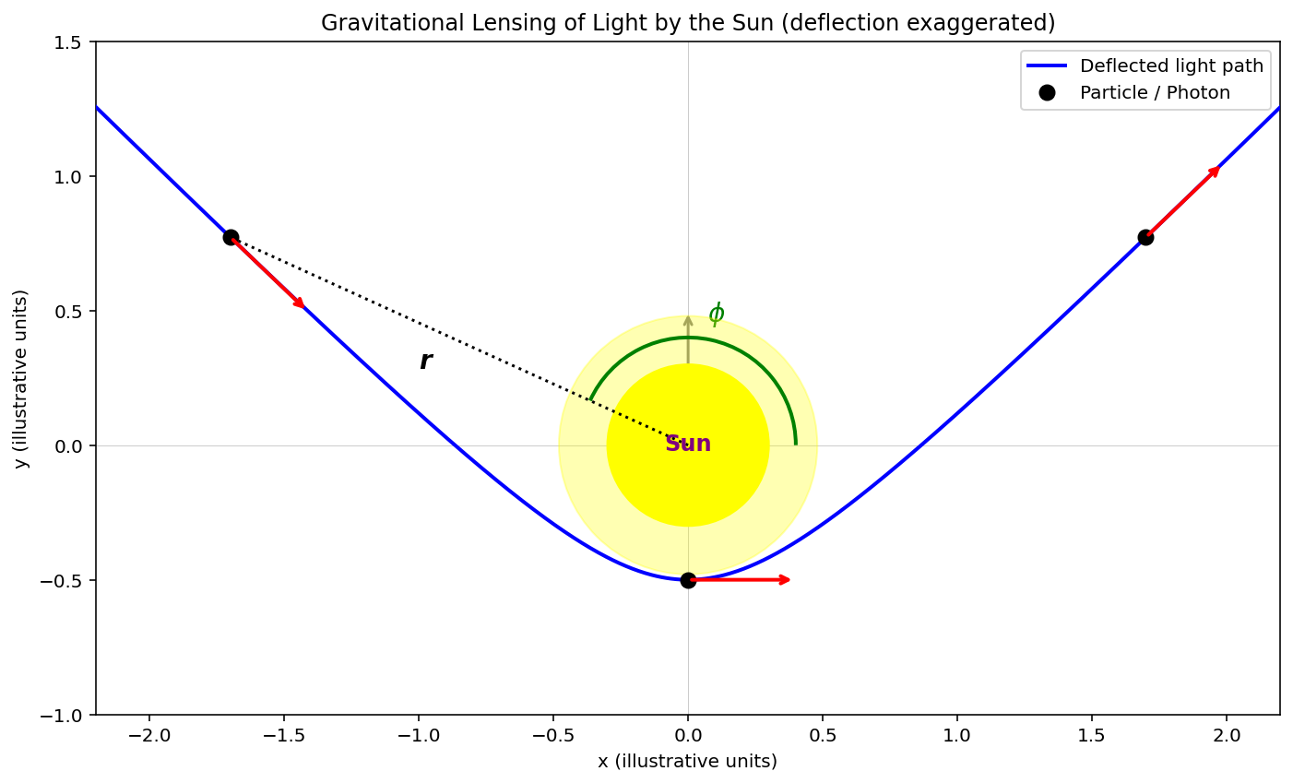
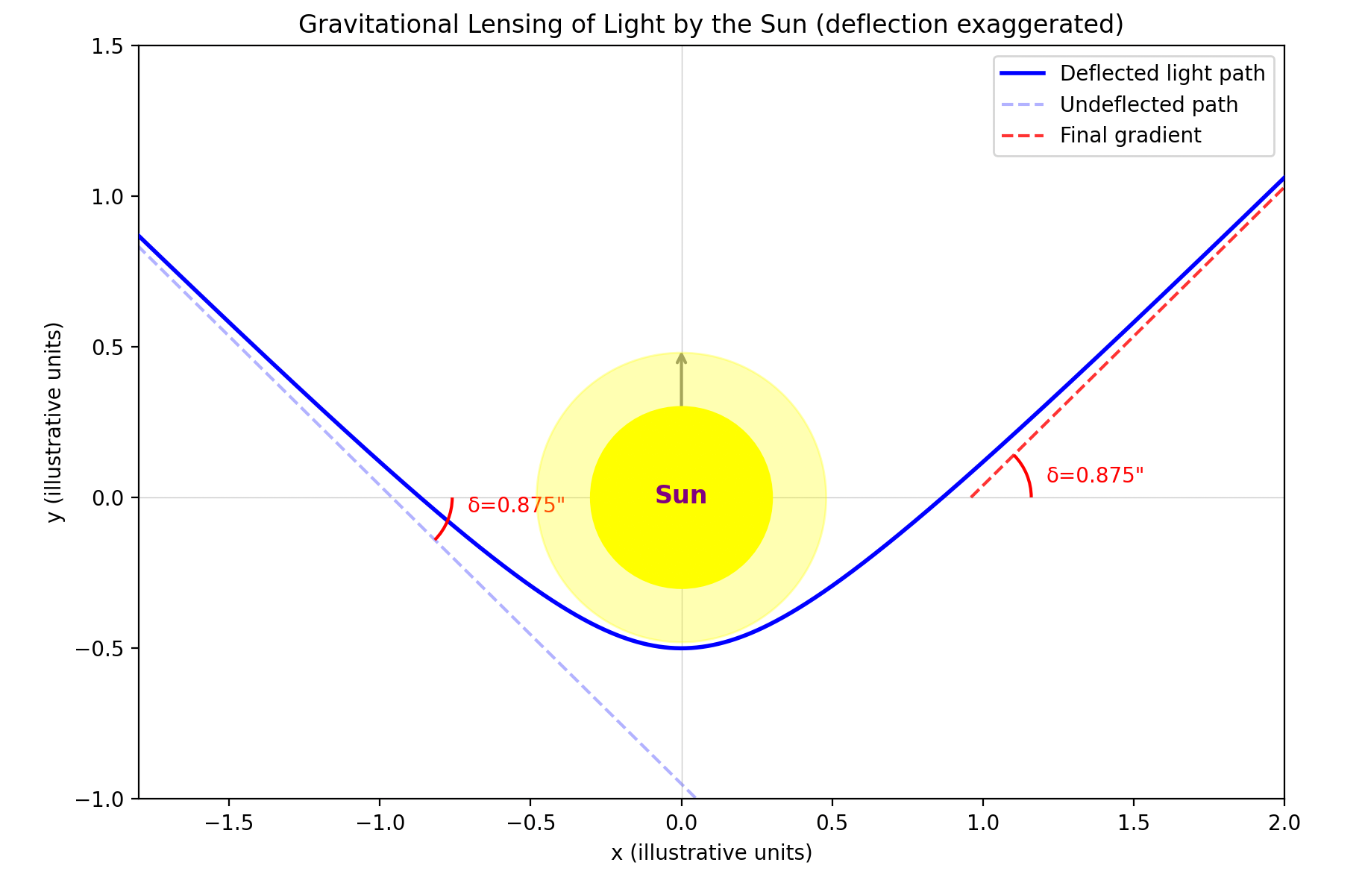
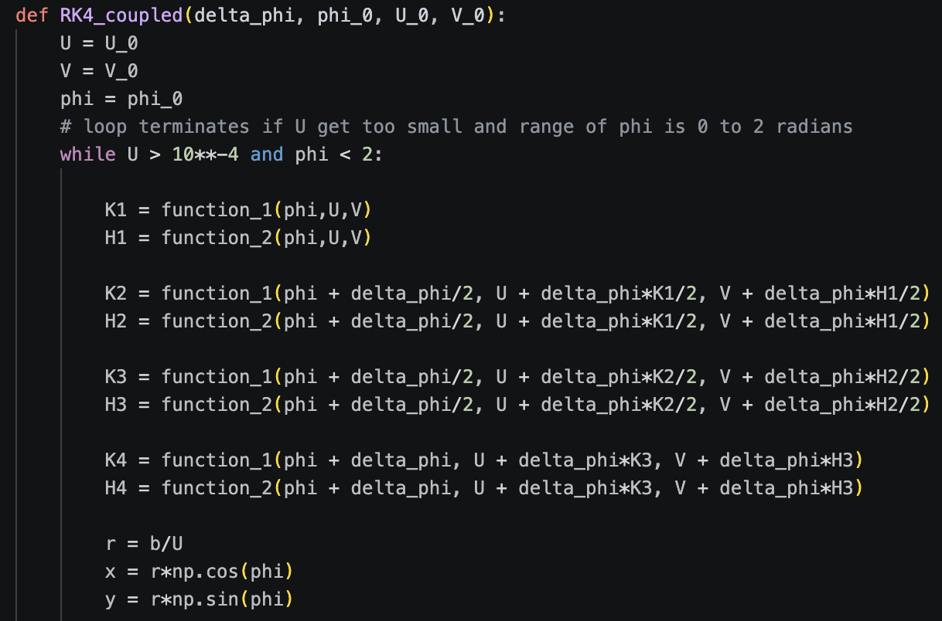
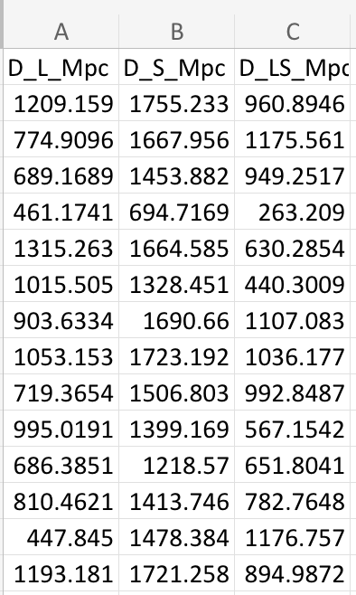
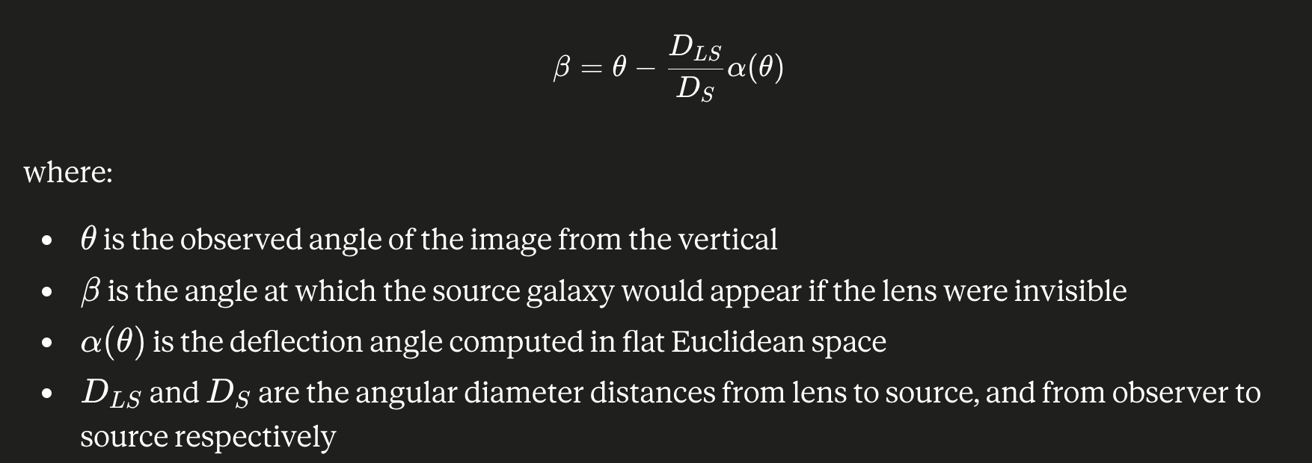
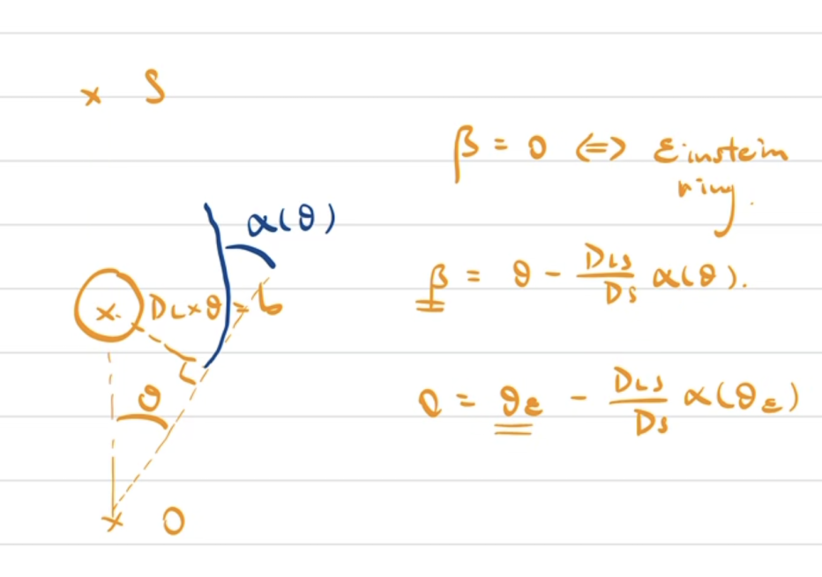

Gravitational Lensing
1. Abstract
Imagine holding up a magnifying glass and seeing objects bend and bend around the lens. Now imagine that instead of glass, the "lens" is an entire galaxy — and instead of light refracting through glass, the light is being bent by gravity itself.
Einstein was the first to show this: by his fascinating equivalence principle, he concluded that mass bends light. And objects with enough mass like distant galaxies, could bend light so much that light behind it gets bent around it from all sides and refocused toward us — forming a glowing ring in the sky. This is called an Einstein Ring.
In this project, we built a computational simulation to model exactly this effect — tracing how light paths curve around a massive lens, we aim to investigate and predict the size of an einstein ring created by a "lens" galaxy of mass M at a distance D_S away from earth and compare our computational values to observed data.
2. Methodology: Binary Search [note: the lens is a galaxy not a star, images need to be relabelled]
The essence of our approach is simple: fire light rays from Earth at different angles to the vertical and see where they end up.
We start with an initial guess θ\theta θ — an angle large enough that the light misses the source galaxy entirely, passing straight past the lens. We then try θ/2\theta/2 θ/2: now the light is bent too much and curves in front of the source galaxy. At this point we know the true Einstein Ring angle must lie *somewhere between* θ/2\theta/2 θ/2 and θ\theta θ.
We then repeatedly halve this interval — each new ray cutting our uncertainty in half — until we have pinned down the Einstein Ring angle to extraordinary precision. This is the classical binary search algorithm, here applied to light rays rather than a sorted list.
For each lensing system we simulated, we fired 20 rays from Earth. Since each ray halves the remaining uncertainty, after 20 iterations our final angle is accurate to within:
Δθ=θ0220≈θ01,000,000\Delta\theta = \frac{\theta_0}{2^{20}} \approx \frac{\theta_0}{1{,}000{,}000}Δθ=220θ0​​≈1,000,000θ0​​ where θ0\theta_0 θ0​ is our initial guess — a precision of better than one part in a million.
U guys must understand this !!!!
Question 1: imagine you're in an elevator moving at constant velocity. In your frame of reference, light follows a straight path…
3. Why are we emitting light rays from Earth and seeing where they land on the galaxy, rather than emitting light the source galaxy and seeing where they land on earth?
Because light rays are time-reversible — the path a ray takes from A to B is identical to the path it would take from B to A. We can exploit this. Rather than asking "which rays leaving the galaxy eventually reach Earth?", we instead ask “if a light ray has reached earth, where are the only places it could have come from?”
To see why, picture a telescope on Earth with an infinitesimally narrow field of view, accepting only light arriving at angle θ\theta θ to the vertical. We can find the only places that that light beam could have originated from by tracing a ray *outward* from Earth at angle θ\theta θ and follow it. This is physically equivalent to running time in reverse: we are giving the light beam -1 times its velocity at that instant and following its path back in time!
The computational saving is dramatic. For 70 Einstein Ring systems at 20 rays each, Leiyi’s 1800 pound macbook pro took 40 minutes. Granted his macbook wasn’t using all of its computational power, to nonetheless achieve the same precision by emitting rays *from* the source galaxy instead would require 2^20 rays per system instead of 20. This would increase the computation time to an estimated 4 years and 32 days!
4. Theory: RK4 [SELF NOTE: make this go after binary search, binary search ray tracing motivates use of RK4. Also raytracing needs to be explained]
But how would we figure out the path that the light takes out of the telescope? The answer is to use the differential equations governing the light’s motion!
Differential equations are the mathematics that encode the secrets of the universe. They describe how temperature diffuses through metal, how perfume spreads through air, and in our case, how light bends around a galaxy.
However, differential equations only describe how things change — not what the answer actually is. Sometimes the way things change is so complicated that no closed-form solution exists, or if one does exist, it can't be written in terms of functions you and I are familiar with.
In our case, the equation describing light's motion around a mass does have an exact solution — but it comes out as a series of elliptic integrals, which are notoriously difficult to evaluate accurately. So while the solution exists on paper, it isn't practical to use.
The workaround is numerical integration. The intuition is simple: if you know how something is changing at an instant, you can make a small step forward in time and estimate where it ends up. Repeat that millions of times and you trace out the full trajectory. The naive version of this — just computing dv = a·dt and dx = v·dt = a * dt^2 — accumulates errors quickly. The RK4 method fixes this by being cleverer about which estimate of the gradient to use at each step, achieving much higher accuracy for the same computational cost.
Fig []
The differential equation describing
The moiton of light around a black hole
5. Prong 1: 1.75 arcseconds
In 1919, Einstein made a striking numerical prediction: a light ray that just barely grazes the surface of the Sun would be deflected by exactly 1.75 arcseconds (0.000486°). Reproducing this result computationally is an ideal first test of our ray-tracing method.
Recall that the equation governing light trajectory around mass is [insert equation]. RK4 can only be applied on first order equations. Since this is a second order differential equation, we would need to introduce a new variable dU/dPhi to break the equation down into 2 first order equations, and then apply RK4 twice.
Both can now be stepped through simultaneously by RK4, provided we supply initial values of ϕ, u, and w
Question for audience:
For the closest approach grazing surface of the sun, what is phi, u, and w?
6. Prong 2: implementing the ray tracing model by emitting light rays from earth.
Recall we can do this because light rays are time-reversible! The only challenge now is changing the initial conditions of our model so that the ray starts at the earth and is emitted at an angle ‘theta’ to the vertical. Recall that we only needed values of phi, U, and, dU/dphi to pass this information to the model. Can anyone tell me what they are? (Ans: phi = -pi/2, U = D_L, the distance to the lens galaxy, dU/dphi = is the hard part, but it’s equal to 1/(rtan(theta)) after some easy maths!)
7. Prong 3: Extracting Einstein Ring Radii via Binary Search Ray-Tracing
This is where we encountered a fundamental obstacle: the expansion of the universe.
Our model consistently underpredicted Einstein Ring radii, with errors growing larger for more massive lens galaxies. The root cause became clear when we examined the distances involved: our computed value of DS−DLD_S - D_L DS​−DL​ did not equal DLSD_{LS} DLS​, where DSD_S DS​, DLD_L DL​, and DLSD_{LS} DLS​ are the angular diameter distances to the source, to the lens, and from the lens to the source respectively. These distances were derived from available redshift data.
This inconsistency arises because the universe is expanding. In a flat, static spacetime, DS−DL=DLSD_S - D_L = D_{LS} DS​−DL​=DLS​ exactly. But in an expanding universe, angular diameter distances do not add linearly. We had anticipated that the null geodesic equation would remain valid locally near the lens galaxy, even in an expanding universe. What we did not anticipate was that the non-Euclidean geometry of the large-scale distance relationships would so significantly corrupt the input parameters to our model. [show some values]
A secondary source of error is our treatment of the source galaxy as a point mass. In reality, accurately modelling light trajectories through the source galaxy would require knowledge of its mass density profile and physical radius — data that was not available to us. Furthermore, any point mass sufficiently massive to deflect light acts as a black hole in our model, making it impossible for light rays to reach its centre at all. The point-source approximation is therefore not merely a simplification but a necessity given our constraints.
2. Why are we emitting light rays from Earth and seeing where they land on the galaxy, rather than emitting light the source galaxy and seeing where they land on earth?
There is a clear systematic error
This model was not very reliable:
R-Squared: 0.8494 (Closer to 1.0 is better)
MAPE: 9.62% (Average % error)
RMSE: 0.5611 kpc
6. Our Updated Model
To address the failures of direct ray-tracing at cosmological distances, we adopted the thin lens approximation, which replaces full ray-tracing with an analytically cleaner framework that naturally incorporates the expansion of the universe.
The key equation is the lens equation
The cosmological expansion of the universe is captured through the ratio DLS/DSD_{LS}/D_S DLS​/DS​, which accounts for the non-Euclidean relationship between distances that invalidated our previous approach.
An Einstein Ring occurs when β=0\beta = 0 β=0 — the source lies perfectly behind the lens, so:
To solve this, we note that as θ\theta θ increases, the light ray passes further from the lens and is deflected less, so α(θ)\alpha(\theta) α(θ) is strictly decreasing. This means β(θ)\beta(\theta) β(θ) is strictly increasing — it has exactly one root, which we can locate efficiently using binary search, for the same reasons as before.
[Insert binary search diagram here]
Our results using this updated model were significantly more consistent with observed Einstein Ring radii. Strikingly, accurate predictions required using the total mass of the lens galaxy — visible matter plus dark matter — rather than visible mass alone. Models using only visible mass systematically underpredicted the Einstein Ring radius, implying the presence of additional unseen mass.
[Insert comparison graph here]
This is a compelling independent line of evidence for the existence of dark matter.
However, as can be seen here, there is still a very small systematic error in the model, which is causing it to overestimate the radii of the rings.
Our final model was very reliable:
R-Squared: 0.9980 (Closer to 1.0 is better)
MAPE: 1.52% (Average % error)
RMSE: 0.0649 kpc
MAE: 0.0598 kpc

